Slide 1
Robust and Secure Routing For Queuing Networks and Internet of Vehicles
Qian Xie
qianxie@nyu.edu
July 10, 2020

Slide 2
Outline
Background of queuing model
Robust routing for network systems
Application to district routing
Secure routing for parallel queues

Slide 3
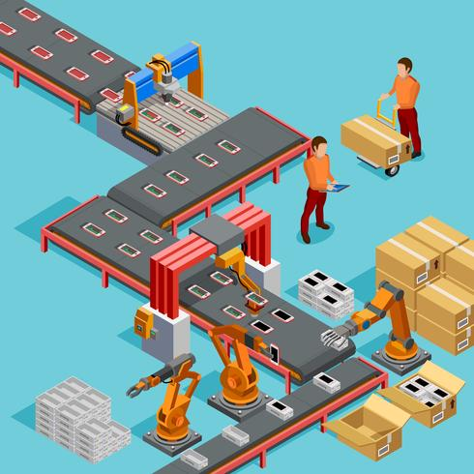
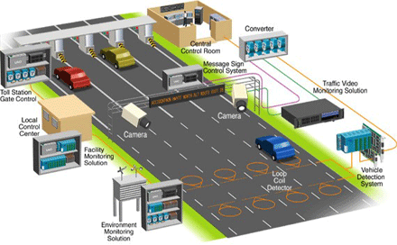
Queuing model
What it captures: queuing due to random arrival and/or random service time
What it not captures: demand & capacity fluctuations
Study topics: routing, sequencing, service rate control, admission control
Applications: transportation, manufacturing networks (production lines), communication/computer networks

Slide 4
Robust routing for network systems
In practical settings, model data may be
unavailable
hard to estimate
vary over time
Suppose that we know the topology of a network, but do not know the demand and supply/capacity

Slide 5
Learning-based vs. robust control
How to make decisions in an unknown environment?
Solution 1: learn the environment from observation
learning-based adaptive control
efficient & smart
requires sufficient data
vulnerable to unhealthy data
Solution 2: independent of environment parameters
robust control
easy & robust
guarantee stability but not efficiency
resist modeling error and/or non-stationary environment
Solution 2 motivates model-based independent control

Slide 6
Formulation
Multi-class Jackson queuing network with with Poisson arrivals & exponential service times
Multiple origins, multiple destinations, acyclic
Real-time OD-specific queue sizes can be observed
Control actions: routing, sequencing, and holding
Arrival and service rates unknown

Slide 7
Join the shortest queue
Simple case: parallel queues
Intuitive routing policy: join the shortest queue (JSQ)
route the arrival to the shortest queue
ties are broken uniformly at random
Standard results:
System is stable if and only if arrival rate < total service rate
Optimal for symmetric servers
MDI: no info about arrival/service rates are needed
Throughput-maximizing: if demand < capacity, then system is stable

Slide 8
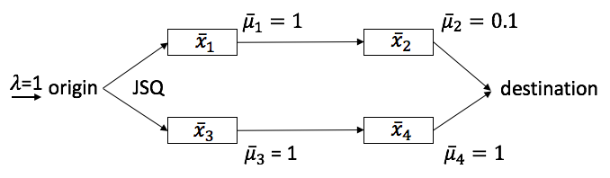
JSQ fails for networks
Can we extend JSQ to networks? No!
By symmetry & Burke’s theorem, departure process from servers 1 & 3 are both Poisson of rate 0.5
However, 0.5 exceeds the service rate of server 2 (0.1)
Thus, the network is unstable!

Slide 9
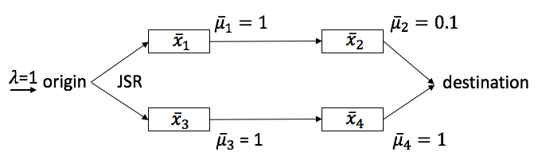

Solution: join the shortest route
Why JSQ fails?
Server 2 will be congested, but such information is not used at the origin
To fix this, consider the total queue sizes on each route:
Join queue 1 if $\overline{x}1+\overline{x}2<\overline{x}3+\overline{x}4$
Join queue 3 if $\overline{x}1+\overline{x}2>\overline{x}3+\overline{x}4$
Ties broken uniformly at random
Improve JSQ to JSR

Slide 10

How about more complex networks?
What if the network is not parallel/serial?
Consider expanded network
Then the previous route-sum is not easy to extend.
We consider an alternative:
$y_{1}=max⁡\{x_{1a},{\frac{1}{2}(x}_{1a}+x_{2})\}, y_{2}=max⁡\{x_{1b},{\frac{1}{2}(x}_{1b}+x_{3}),{\frac{1}{3}(x}_{1b}+x_{3}+x_{5a})\}$, $y_{3}=max⁡\{x_{4},{\frac{1}{2}(x}_{4}+x_{5b})\}$

Slide 11

Multi-class centralized control
Join the shortest ”route”: $\min_{k}{ y}_{k}$
This applies to multi-class (multi-OD) traffic
Centralized control: requires global information
JSR is model-data independent
Joint work with Li Jin (submitted to IEEE-TCNS)

Slide 12
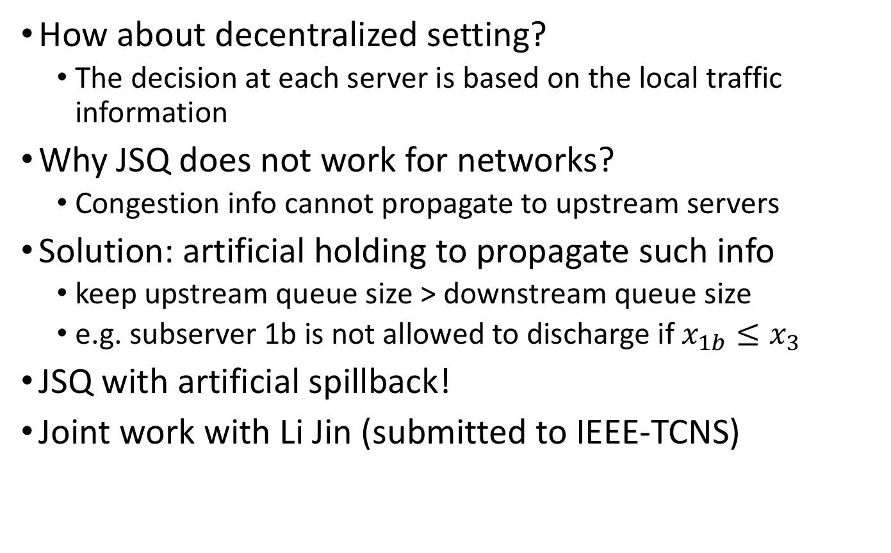
Single-class decentralized control
How about decentralized setting?
The decision at each server is based on the local traffic information
Why JSQ does not work for networks?
Congestion info cannot propagate to upstream servers
Solution: artificial holding to propagate such info
keep upstream queue size > downstream queue size
e.g. subserver 1b is not allowed to discharge if $x_{1b}≤x_{3}$
JSQ with artificial spillback!
Joint work with Li Jin (submitted to IEEE-TCNS)

Slide 13
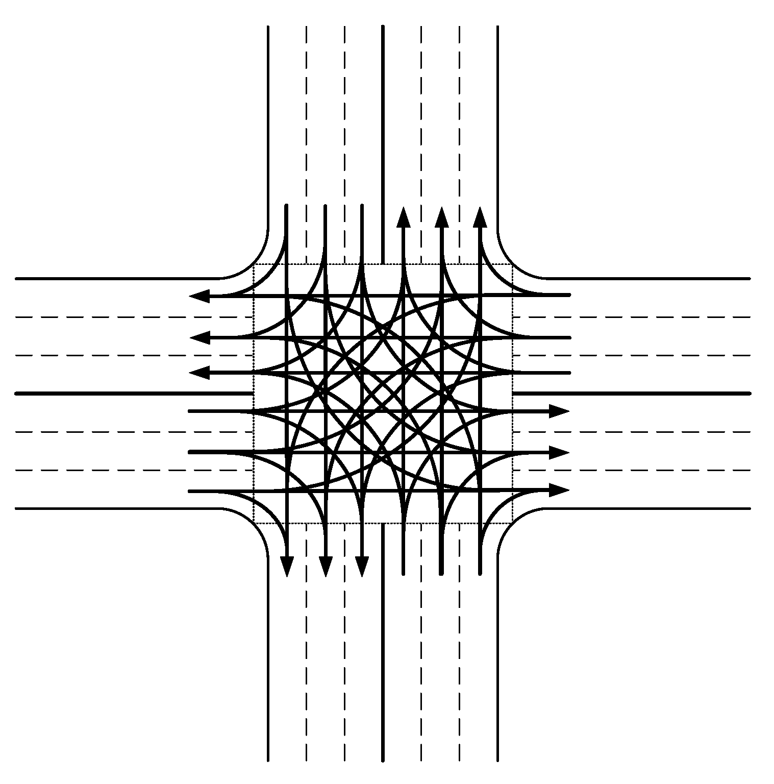
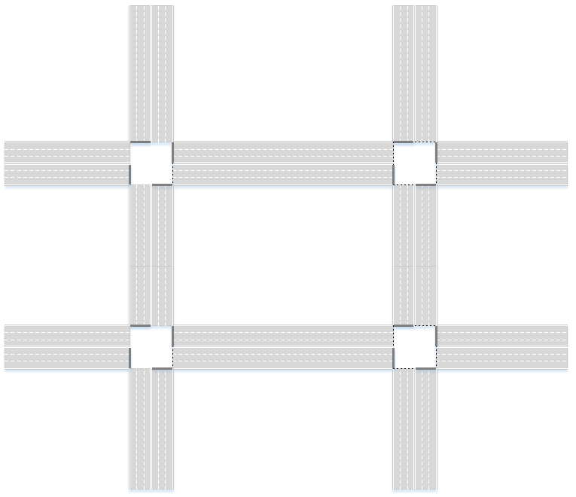
Application to district routing
Find routes for all CAVs in a district
Objective: minimize the average traveling time of CAVs
Actions: assigning routes to CAVs
Constraints:
Physical constraints/sequencing in the driving environment (AIM, CAV moving…)
CAVs has their own source and destination

Slide 14
Training of RL
Joint work with NYU ECE High Speed Networking Lab
Routes for all CAVs
Routing Algorithm
(Reinforcement Learning)
minimize the traveling time
State
M/D/1 network
Reward
Driving environment

Slide 15
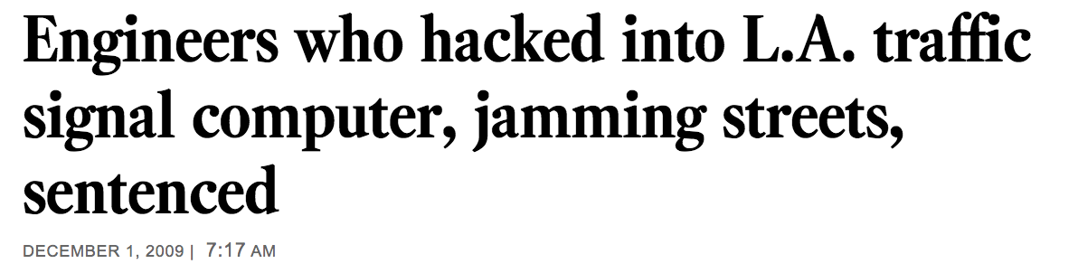
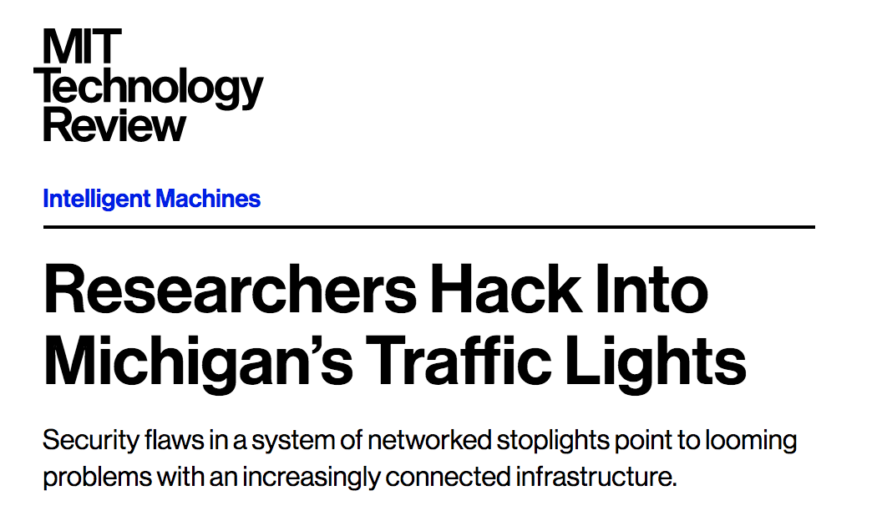
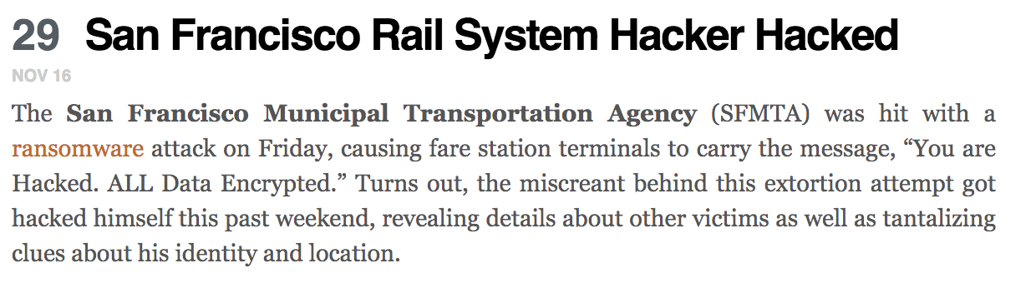
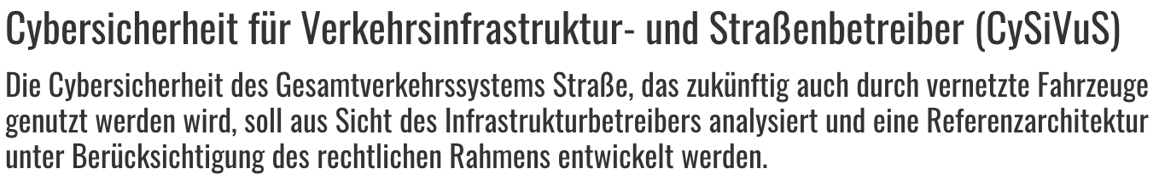
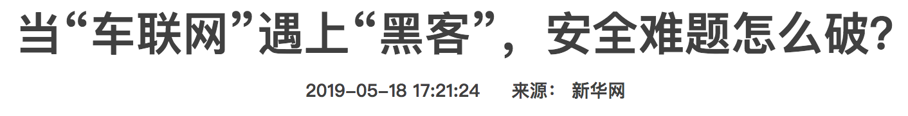
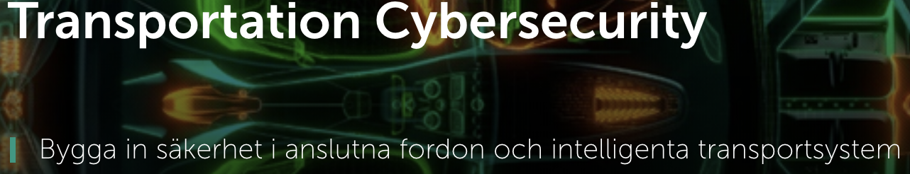
Security risks in cyber-physical systems
Cyber-physical systems rely on data flowing through the network
Cyber components are vulnerable to malicious attacks that bring security risks
How does data quality/integrity impact performance?
How cyber security vulnerabilities impact physical system?

Slide 16
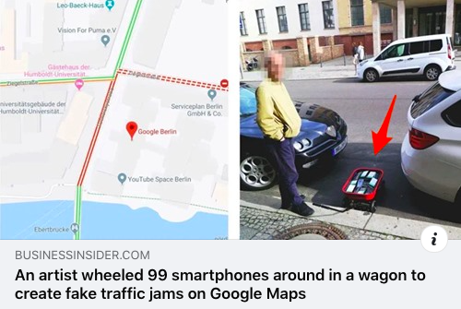
Malicious behaviors in IoV
In the Internet of Vehicles (IoV), vehicles typically make decisions based on real-time routing guidance services
The info provided by such services can be faulty, and the misled travelers may suffer extra travel times

Slide 17
Security vulnerabilities in ITSs

Slide 18
Research questions
Modeling & analysis
How to model stochastic & recurrent attacks?
How to quantify attacker’s incentive?
How to quantify the impact due to attacks?
How to evaluate security risk?
Resource allocation
How to allocate security resources, including redundant components, diagnosis mechanisms, etc.?
Control design
How to design traffic control strategies that are less sensitive to various types of attacks?

Slide 19
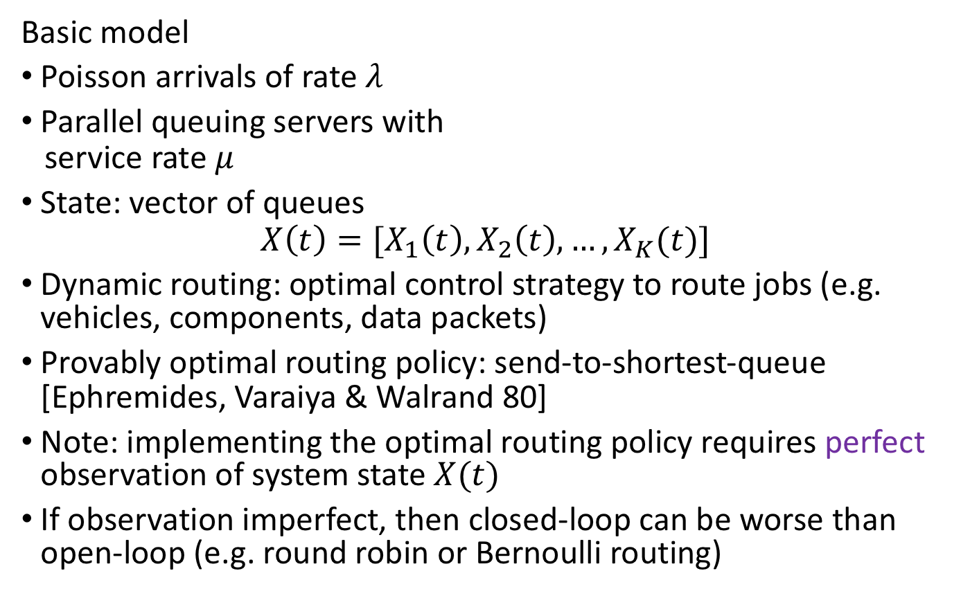
Queuing model
$$x_{1}(t)$$
Basic model
Poisson arrivals of rate $λ$
Parallel queuing servers with
service rate $μ$
State: vector of queues
$$X\left(t\right)=[X_{1}\left(t\right),X_{2}\left(t\right),…,X_{K}(t)]$$
Dynamic routing: optimal control strategy to route jobs (e.g. vehicles, components, data packets)
Provably optimal routing policy: send-to-shortest-queue [Ephremides, Varaiya & Walrand 80]
Note: implementing the optimal routing policy requires perfect observation of system state $X(t)$
If observation imperfect, then closed-loop can be worse than open-loop (e.g. round robin or Bernoulli routing)
$$μ$$
$$x_{2}(t)$$
$$μ$$
$$λ$$
$$s$$
$$t$$
$$μ$$
$$x_{3}(t)$$

Slide 20
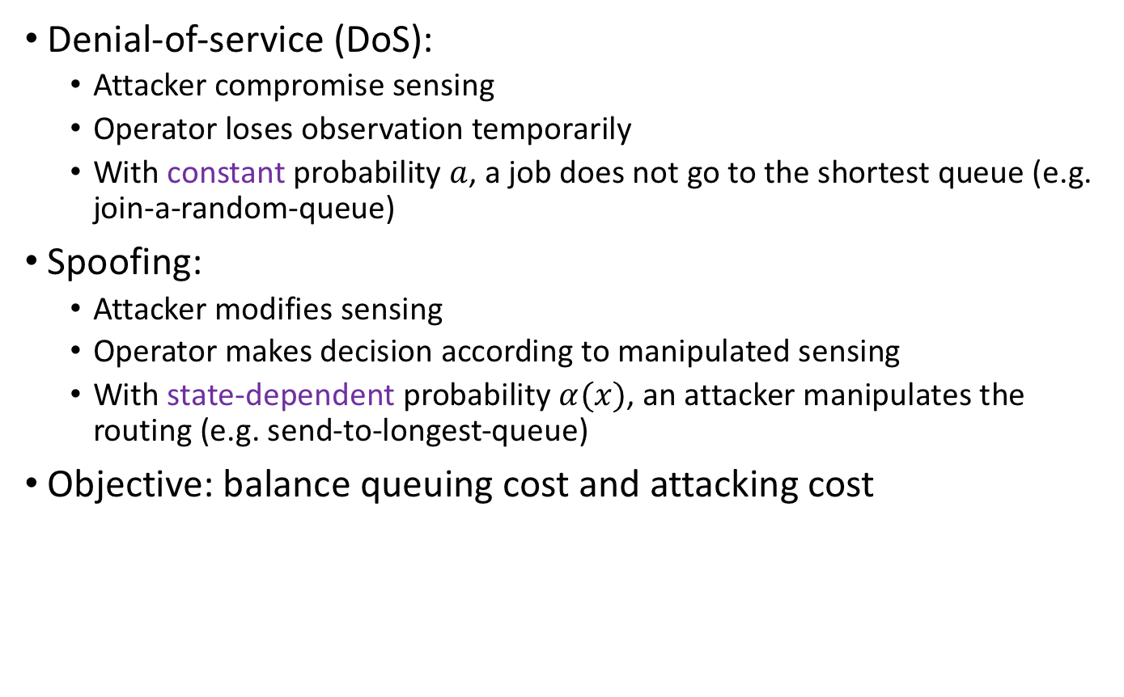
Failure (attacker) model
Denial-of-service (DoS):
Attacker compromise sensing
Operator loses observation temporarily
With constant probability $a$, a job does not go to the shortest queue (e.g. join-a-random-queue)
Spoofing:
Attacker modifies sensing
Operator makes decision according to manipulated sensing
With state-dependent probability $α(x)$, an attacker manipulates the routing (e.g. send-to-longest-queue)
Objective: balance queuing cost and attacking cost

Slide 21
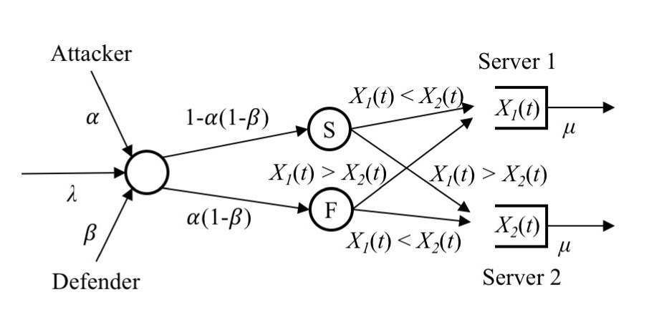

Defender model
Decision making:
With probability $β(x)$, the system operator (defender) secures the routing (i.e. ensuring correct routing)
Objective: balance queuing cost and defending cost
Routing is compromised if and only if attacked & not defended
i.e. $α\left(x\right)=1$ & $β\left(x\right)=0$ or $α\left(x\right)\left(1−β\left(x\right)\right)=1$

Slide 22
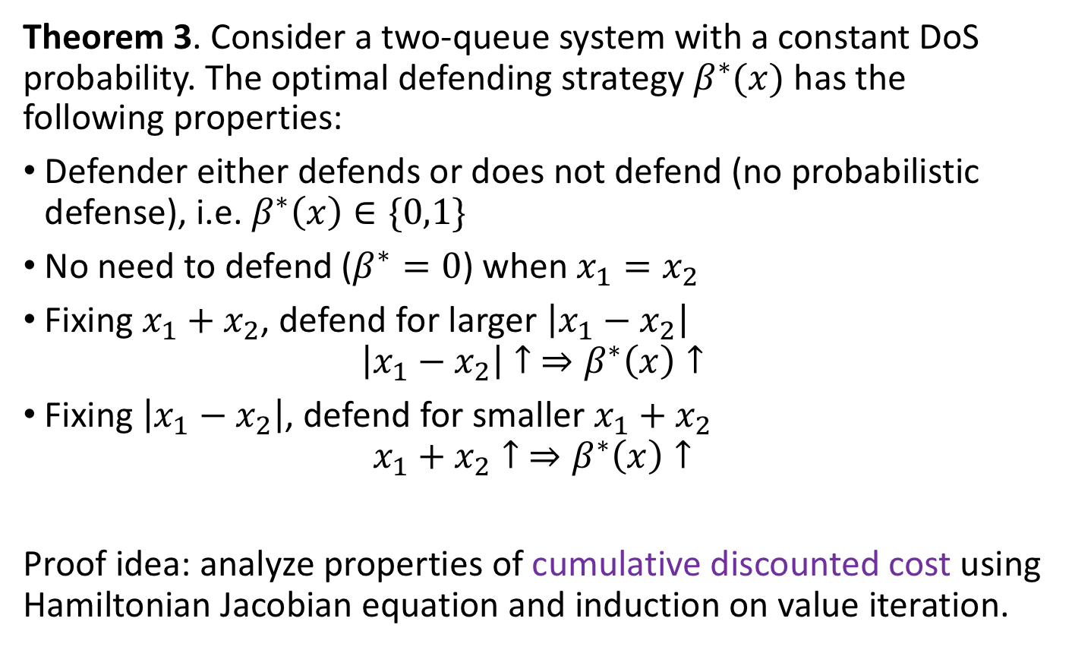
Defending strategy (constant DoS probability)
Theorem 3. Consider a two-queue system with a constant DoS probability. The optimal defending strategy $β^{∗}(x)$ has the following properties:
Defender either defends or does not defend (no probabilistic defense), i.e. $β^{∗}\left(x\right)∈\{0,1\}$
No need to defend ($β^{∗}=0$) when $x_{1}=x_{2}$
Fixing $x_{1}+x_{2}$, defend for larger $\left|x_{1}−x_{2}\right|$
$$\left|x_{1}−x_{2}\right|↑ ⇒β^{∗}\left(x\right)↑$$
Fixing $\left|x_{1}−x_{2}\right|$, defend for smaller $x_{1}+x_{2}$
$$x_{1}+x_{2}↑ ⇒β^{∗}\left(x\right)↑$$
Proof idea: analyze properties of cumulative discounted cost using Hamiltonian Jacobian equation and induction on value iteration.

Slide 23
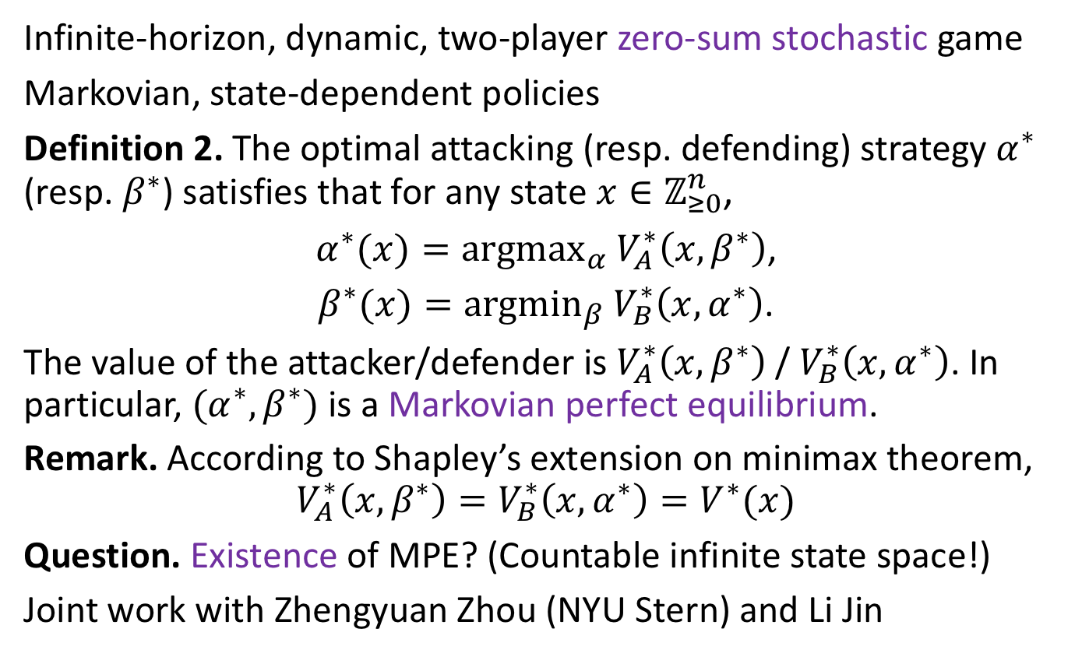
Security game
Infinite-horizon, dynamic, two-player zero-sum stochastic game
Markovian, state-dependent policies
Definition 2. The optimal attacking (resp. defending) strategy $α^{∗}$ (resp. $β^{∗}$) satisfies that for any state $x∈ℤ_{≥0}^{n}$,
$α^{∗}(x)={argmax}_{α}$ $V_{A}^{∗}\left(x,β^{∗}\right)$,
$β^{∗}(x)={argmin}_{β}$ $V_{B}^{∗}\left(x,α^{∗}\right)$.
The value of the attacker/defender is $V_{A}^{∗}\left(x,β^{∗}\right)$ / $V_{B}^{∗}\left(x,α^{∗}\right)$. In particular, $(α^{∗},β^{∗})$ is a Markovian perfect equilibrium.
Remark. According to Shapley’s extension on minimax theorem,
$$V_{A}^{∗}\left(x,β^{∗}\right)=V_{B}^{∗}\left(x,α^{∗}\right)=V^{∗}(x)$$
Question. Existence of MPE? (Countable infinite state space!)
Joint work with Zhengyuan Zhou (NYU Stern) and Li Jin

